Slide 1


Enterprise Integration Patterns
With RabbitMQ & MicroServices
Franco Poveda

Slide 2

What is Messaging?
Messaging enables high-speed, asynchronous, program-to-program communication.
Programs communicate by sending messages to each other
A producer is a program that sends a message by writing
the message to a channel.
A consumer is a program that receives a message by
reading it from a channel.

Slide 3

What is a Messaging System?
Messaging capabilities are typically provided by a separate
software (messaging system).
The main task of a messaging system is to move messages from the sender’s computer to the receiver’s computer in a reliable fashion.
The reason a messaging system is needed to move messages from one computer to another is that computers and the networks that connect them are inherently unreliable

Slide 4
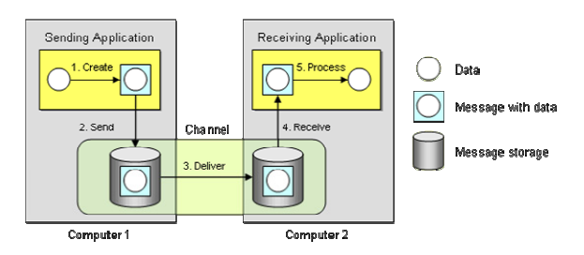
Message Transmission

Slide 5
Demo
RabbitMQ Simulator: http://tryrabbitmq.com/
NodeJS example

Slide 6
Why Messaging Systems?
• Remote Communication
• Platform/Language Integration
• Asynchronous Communication. Messaging enables a send and forget approach.
• Throttling. Too many calls on a single receiver at the same time can overload the receiver.
• Reliable Communication.

Slide 7
Microservices Architecture Patterns
Particular way of designing software applications as independently deployable services.
Each service running in its own process and communicating with lightweight mechanisms.
Becoming the default style for building enterprise applications.
Decentralized control of languages and data.

Slide 8
Monolithic VS Microservices
A monolithic application is built as a single unit
Any changes to the system involve building and deploying entire app.
Hard to keep a good modular structure.
Scaling requires scaling of the entire application rather than parts of it that require greater resource.

Slide 9
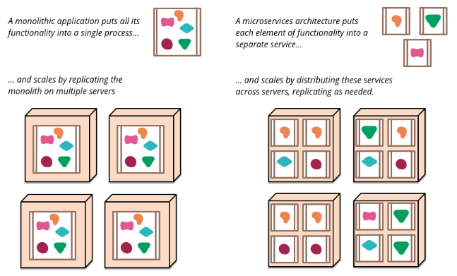

Slide 10
Pros
Deployability: more agility to roll out new versions of a service due to shorter build+test+deploy cycles.
Reliability: a microservice fault affects that microservice alone and its consumers.
Availability: rolling out a new version of a microservice requires little downtime.
Scalability: each microservice can be scaled independently using pools, clusters, grids.
Modifiability: more flexibility to use new frameworks, libraries, datasources.
Management: the application development effort is divided across teams.
Design autonomy: the team has freedom to employ different technologies.

Slide 11
Cons
Deployability: deployment may become more complex with many jobs, scripts and config files.
Performance: services more likely need to communicate over the network, whereas services within the monolith may benefit from local calls. Performance overhead.
Modifiability: Also, mechanisms to improve autonomy, such as eventual consistency and asynchronous calls, add complexity to microservices.
Testability: automated tests are harder to setup and run because they may span different microservices on different runtime environments.
Management: the application operation effort increases because there are more runtime components, log files, and point-to-point interactions to oversee.

Slide 12
Example: image upload and processing

Slide 13
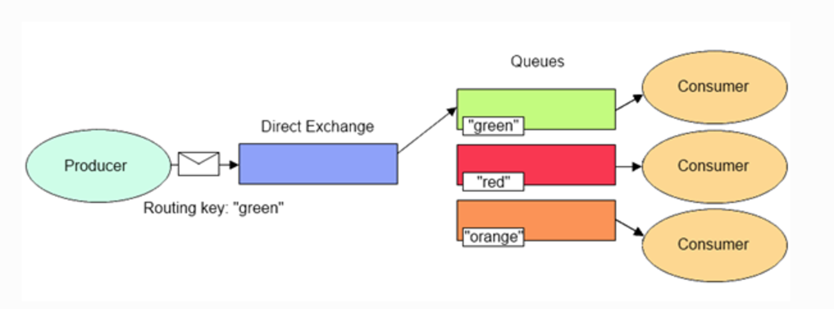
Exchange Types: Direct

Slide 14
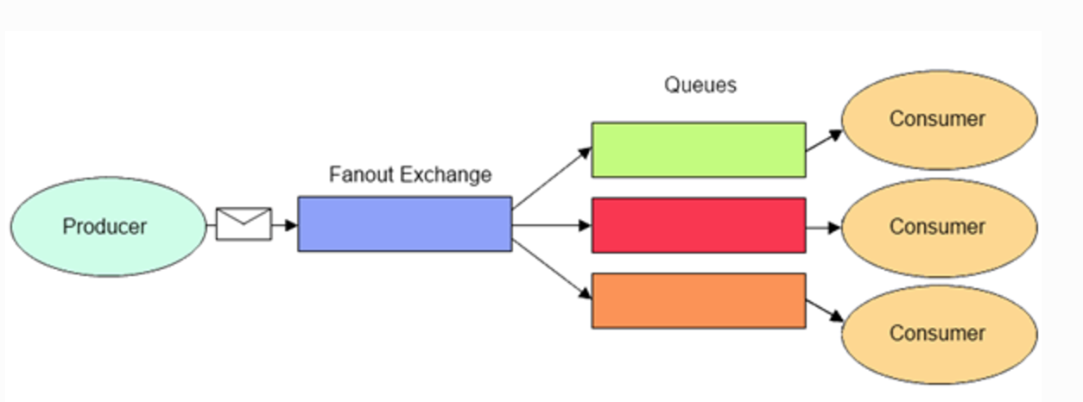
Exchange Types: Fanout

Slide 15
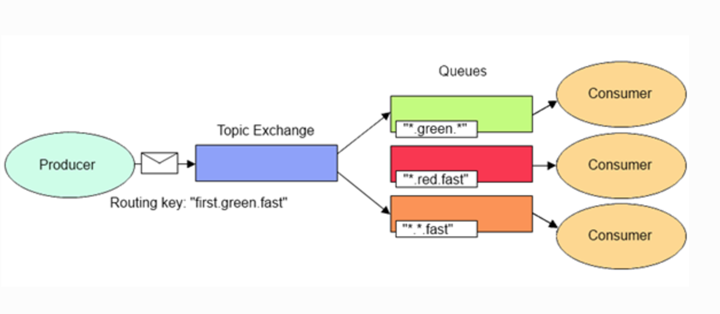
Exchange Types: Topic

Slide 16
New request: video upload & processing
The microservices approach facilitates the introduction of new features and reduces the chances of compromising the rest of the system.
Complexity is also reduced by using different types of exchanges to handle routing.
Applications should be designed with a async webhook/callback in mind.

